Slide 1
Estimation of population parameters
种群参数的估计
Abundance丰度
Fecundity繁殖率
Survival存活率

Slide 2
Scientists know how to count, right??
科学家知道怎么数数，对吧？？
Yet in the U.S. <50% of recovery plans for ESA listed species included an estimate of current population size, N.
75% lacked a rigorous estimate.
然而，在美国，只有不到50%的濒危物种恢复计划包含了对当前种群规模N的估算。而75%的计划缺乏严格的估算。
Why do we know so little
about the size of wild populations,
even when they are of high conservation priority?
为什么即使野生动物具有很高的保护优先级，但我们却对它们的数量知之甚少呢？
Notes:
Only 4% had a trend. For more than 95% of ENDANGERED SPECIES in richest country with data/scientists, no one knew whether the population was growing, shrinking or stable?
ACTIVITY: 2 minutes – to list why – focus on biological reasons

Slide 3
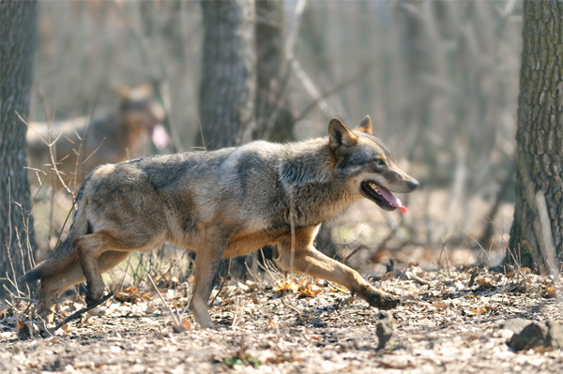
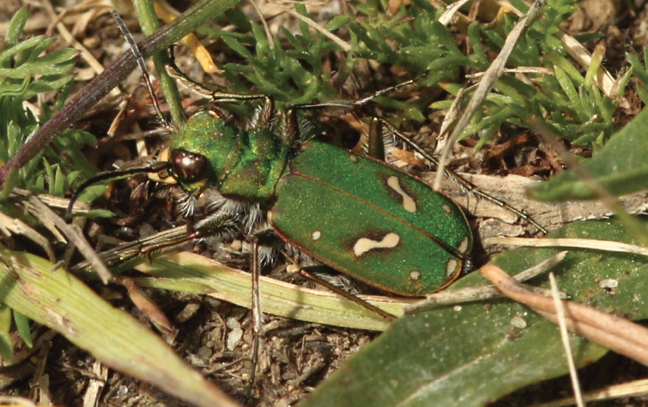
Why is estimating population size so challenging?
估计种群大小为什么如此具有挑战性呢？
Expensive 昂贵
Time consuming 耗时
Biological challenges 生物学挑战:
  Detectability: aquatic species, subterranean spp., elusive spp., cryptic species 可检测性（难以检测到）：水生物种、地下物种、隐蔽物种、隐种
  Mobility 高度移动性
  Wide ranging species
  广泛分布的物种
  Patchy distributions 分布不均匀
Notes:
OHLONE tiger beetle – usually blended in grass, even experts have trouble spotting them, let along making an accurate / comprehensive count.

Slide 4
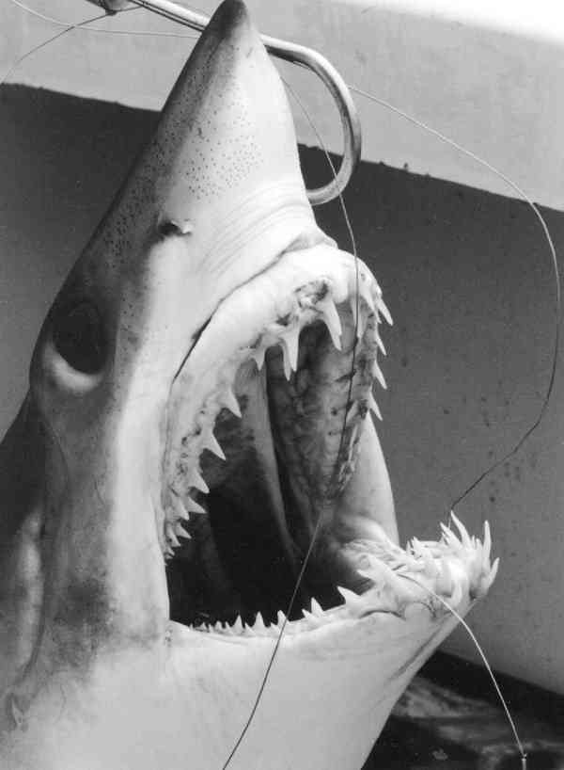
Estimating population size
估算种群大小
Definitions 定义
Census – All individuals are counted (perfect detectability)
普查—对所有个体进行计数（完全可检测性）
Abundance = how many individuals (e.g., 100)
丰度=有多少个体（例如100个）
Density = abundance per unit area (e.g., 10/ha)
密度=每单位面积的丰度（例如每公顷10个）
Sample: usually standardized e.g. by time, space, effort:
e.g. catch per unit effort, individuals detected per time or area unit
样本：通常按时间、空间、工作量等进行标准化
例如，每单位工作量下捕获的数量，单位时间或面积内检测到的个体数量
Notes:
COUNTS work only for IMMOBILE SPEICES, in LTD. Area with all life stages readily visible. FOR MOST SPEICES CENSUSES are impossible or prohibitively expensive.
Index – e.g. fisheries CPUE, species that can’t be seen: e.g. vocalizations or footprints, nests, burrows.

Slide 5
Estimating population size
估算种群大小
Definitions 定义
Abundance estimate – Actual estimate of abundance or density, often by accounting for detectability.
丰度估计—对丰度或密度的实际估算，通常考虑了可检测性
Abundance Index – Some measure assumed to be proportional to abundance or density (relative abundance).
丰度指数—某种假定与丰度或密度（相对丰度）成比例的测量值
Notes:
COUNTS work only for IMMOBILE SPEICES, in LTD. Area with all life stages readily visible. FOR MOST SPEICES CENSUSES are impossible or prohibitively expensive.
Index – e.g. fisheries CPUE, species that can’t be seen: e.g. vocalizations or footprints, nests, burrows.

Slide 6
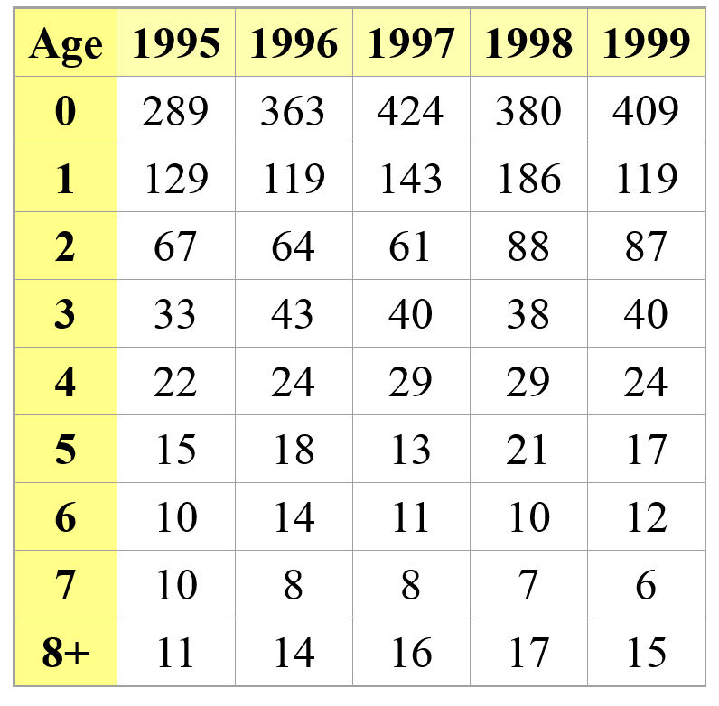
Estimating survival and fecundity using census data
利用普查数据估算存活率和繁殖力
Assume we do several censuses in a closed population (no emigration and immigration), assuming perfect detection
假设我们在一个封闭的种群中进行了多次普查（没有迁入和迁出），并假设检测完美。

Slide 7
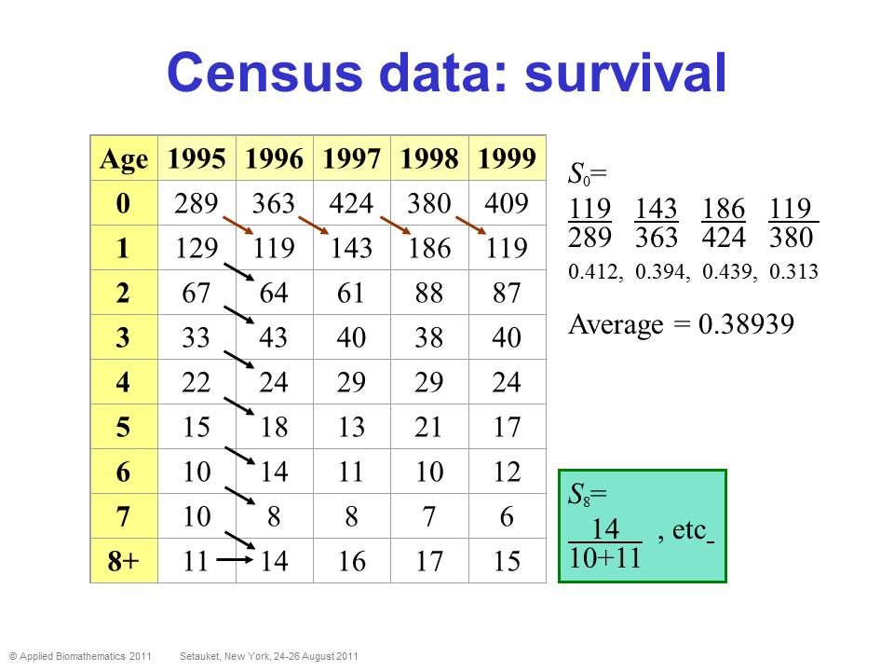
Estimating survival and fecundity using census data
利用普查数据估算存活率和繁殖力
Assume we do several censuses in a closed population (no emigration and immigration), assuming perfect detection
假设我们在一个封闭的种群中进行了多次普查（没有迁入和迁出），并假设检测完美。
普查数据：存活率

Slide 8
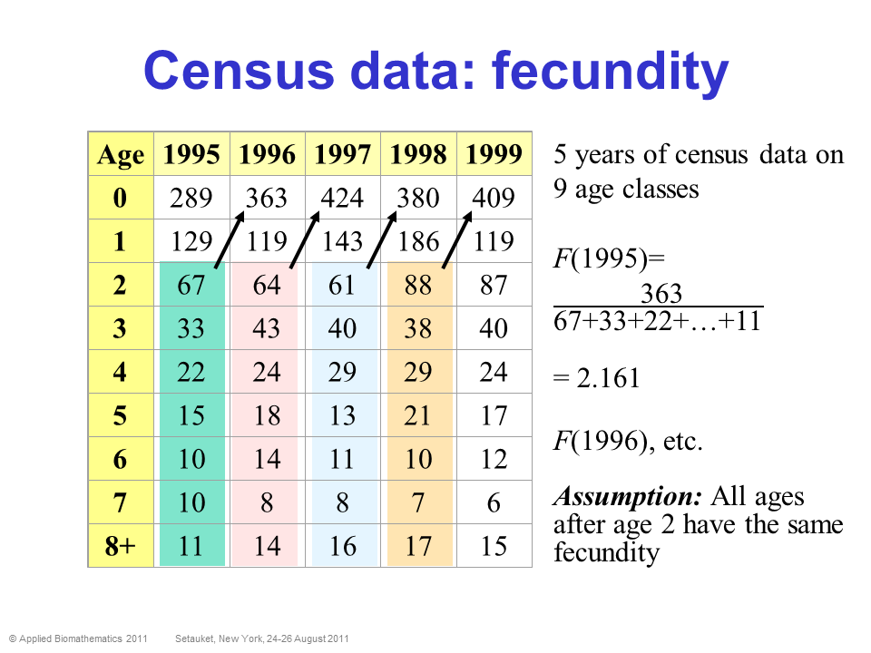
Estimating survival and fecundity using census data
利用普查数据估算存活率和繁殖力
Assume we do several censuses in a closed population (no emigration and immigration), assuming perfect detection
假设我们在一个封闭的种群中进行了多次普查（没有迁入和迁出），并假设检测完美。
普查数据：繁殖力
9个年龄段的5年种群普查数据
假设：2岁以后的所有年龄段的繁殖力都是相同的

Slide 9
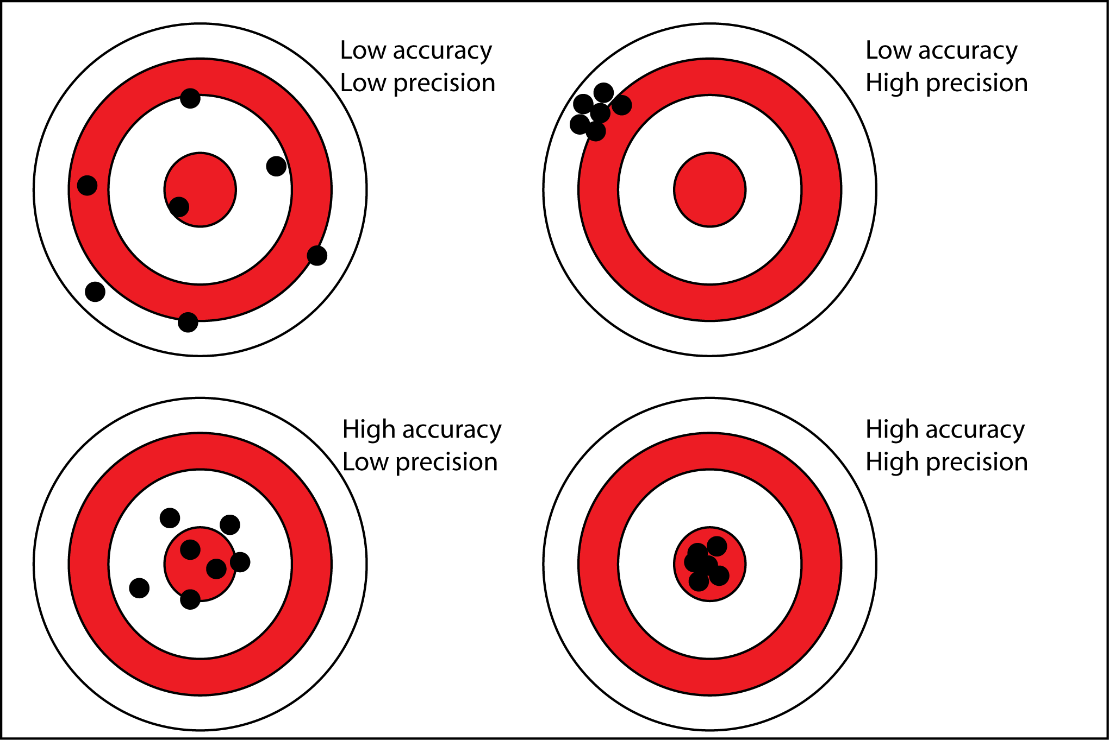
Designing successful sampling to evaluate abundance and density
设计成功的采样方法来评估丰度和密度
Low effort, design could be good or bad
工作量小，采样设计或好或坏的情况
低准确性
低精确性
低准确性
高精确性
Likely high effort, but bad design
工作量可能很大，但采样设计不好的情况
Not high enough effort, good design
工作量不那么大，采样设计好的情况
高准确性
低精确性
高准确性
高精确性
High enough effort, good design
工作量很大，且采样设计好的情况
Trade-offs between accuracy / precision of estimates and effort / cost
在估算的准确性/精确性和工作量/成本之间进行权衡

Slide 10
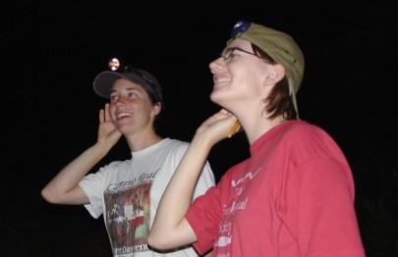
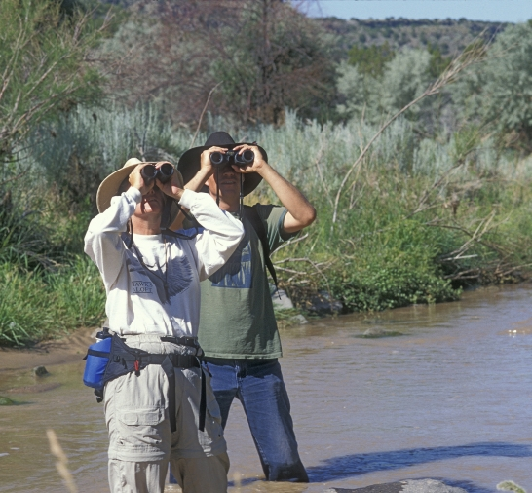
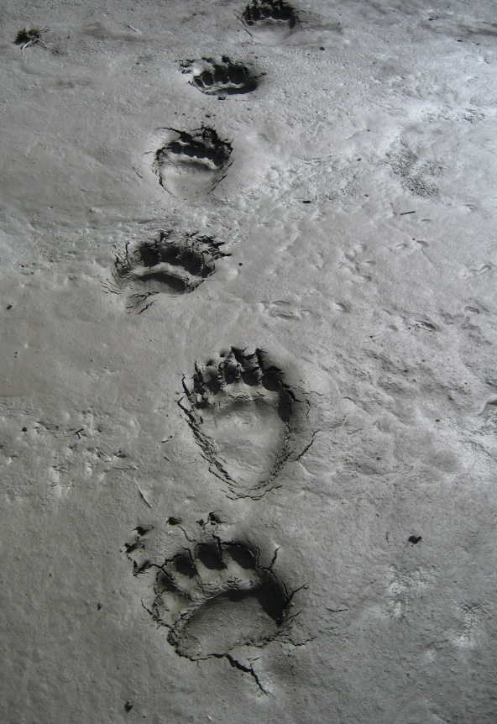
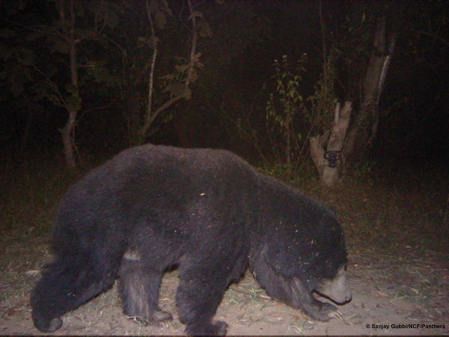
Two main types of data: 1) Unmarked individuals
主要有两类数据：1）未标记的个体
Call Surveys
声音调查
Visual Surveys
视觉调查
Track Surveys
踪迹调查
Photo captures
照片拍摄

Slide 11
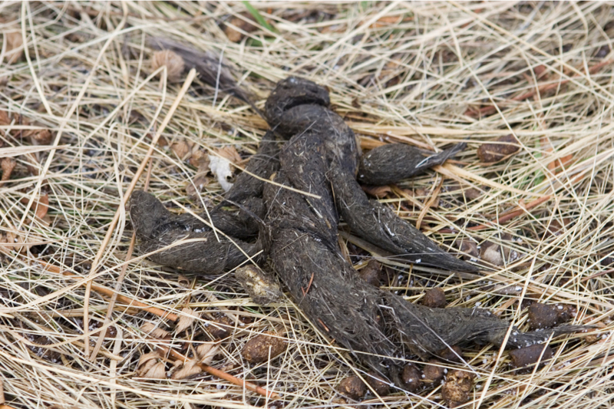
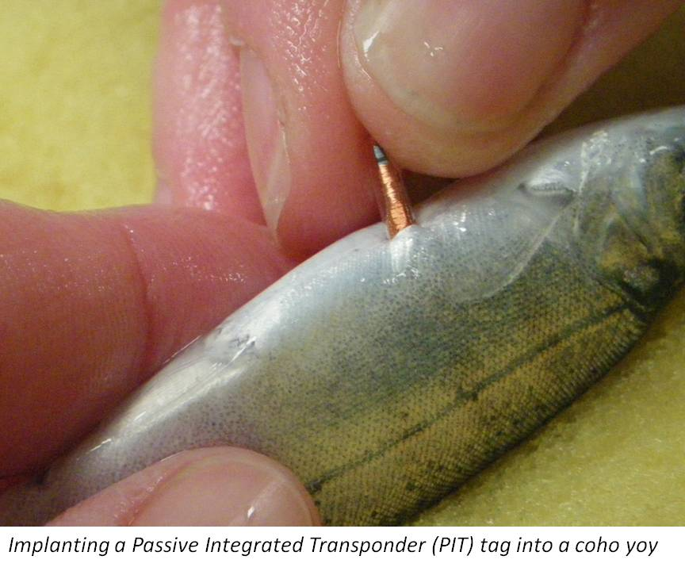
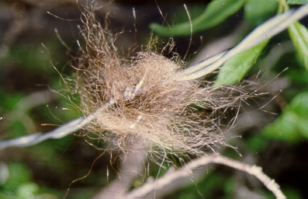
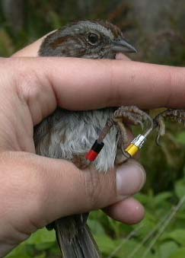
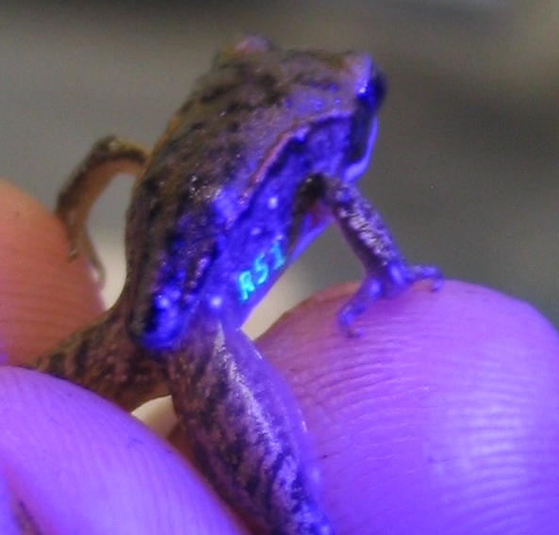
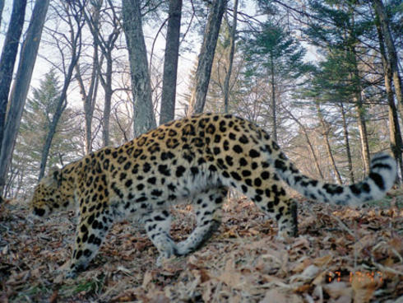
Two main types of data: 2) Marked individuals
主要有两类数据：2）标记的个体
Genotyping
基因分型
PIT tags
活体植入标签
Elastomer tags
嵌入性荧光标签
Bird bands
鸟足识别环
Photo captures (pattern recognition)
照片捕捉（模式识别）

Slide 12
1) Unmarked individuals 未标记的个体
PROS
CONS
Relatively cheap
Less time intensive
Rapid assessment
Does not involve handling animals
Can be done for multiple species simultaneously
优势
相对便宜
时间投入较少
快速评估
无需处理动物
可同时适用于多个物种
Can only provide relative abundances
Unreliable for estimating population trends (usually large confidence intervals)
Of limited use for some management and conservation applications (e.g., hunting, setting population increase targets)
缺点
仅能提供相对丰度
在估计种群趋势方面不够可靠（通常存在较大的置信区间）
在某些管理和保护应用中受限（（例如狩猎、设定种群增长目标）

Slide 13
2) Marked individuals 标记的个体
Can provide absolute abundances
Best for estimating population trends (usually tight confidence intervals)
Best for conservation and management, but not always attainable
可提供绝对丰度
最适合估计种群趋势（通常置信区间较小）
最适合于保护和管理，但并非总是可行
More expensive (e.g., genotyping) and time consuming
May involve handling animals (except camera trapping and genotyping)
Usually focuses on a single species
更昂贵（如基因分型）、更耗时
可能涉及处理动物（除了相机陷阱和基因分型）
通常侧重于单一物种

Slide 14
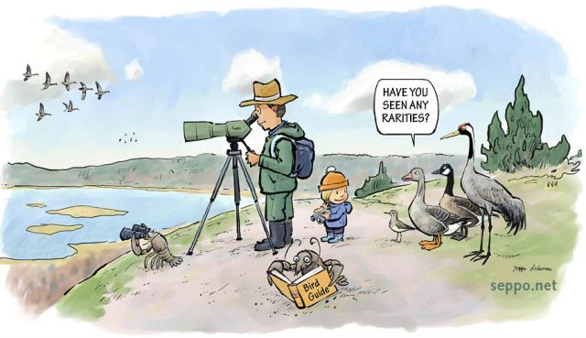
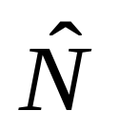
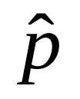
Detectability – key quantity in monitoring
可检测性—监测中的关键量
Not accounting for detection underestimates abundance because the observer cannot see REALITY (cannot count ALL individuals present at a site)
若不考虑检测因素则会低估物种丰度。因为观察者无法看到真实情况（无法统计某个地点的所有个体）。
Count of animals
observed
观察到的动物数量
C
Estimated
abundance
丰度估计
=
Estimated
detectability
估计值的可检测性
Common abundance estimation techniques include常见的物种丰度估计方法包括 :
Distance sampling (unmarked individuals) 距离采样（未标记个体）
Occupancy methods (unmarked individuals) 占用率方法（未标记个体）
Capture-recapture methods (marked individuals) 捕获—再捕获方法（已标记的个体）
Notes:
SOME SIMPLE EXAMPLES OF HOW TO INC. THESE NON-STANDARD FACTORS INTO MODELS…. e.g. if p = 0.5…

Slide 15


Distance sampling 距离采样
Assumes that detection probability decreases with distance from the observer, but that actual density stays constant
假设检测概率随观察者距离的增加而降低，但实际种群密度保持不变
Detection
probability
检测概率
Distance 距离
50 meters
25 meters
10 meters
p=0.5
p=1.0
p=0.25

Slide 16
Capture-recapture methods
捕获—再捕获方法
Capture 捕获
  physical capture 实际捕获
  non-invasive techniques: genetics (from hair snares, scat, etc.), ID unique patterns remotely 非入侵性技术：遗传学（毛发采集、粪便等）、远程身份识别
Mark 标记
    Radiotelemetry, PIT tags, banding, elastomer, photography, genotyping
    使用不同的方法对个体进行标记，例如无线电遥测、PIT标签、环标、嵌入式荧光标签、拍摄和基因分型
Recapture (or resight) 再捕获（或重新观察）
Notes:
Important tools for estimating N for mobile speices…. 1. Research CAPTURES, MARKS, and RELEASES as many individuals as possilbe, # Marked = M
2. Allows enough time for the marked individuals to mix intot the whole populaiton, then
3. Resampled the poupplation recording how many individuals are sampled (s) and how many of them possed the mark from the 1st visit and are therefore recaptured (r)

Slide 17
Capture-recapture methods
捕获—再捕获方法
Open versus closed populations
Closed population – a population in which there is no recruitment (birth or immigration) or losses (death or emigration) during the period of study. Geographic and demographic closure.
Open population – a population that changes in size and composition due to births, deaths, and permanent movements (immigration and emigration)
开放和封闭种群
封闭种群—在研究期间没有新增（出生或迁入）或减少（死亡或迁出）的成员。地理和群体封闭性。
开放种群—由于出生、死亡和永久性迁移（迁入和迁出）而在规模和组成上发生变化的种群。
Notes:
Important tools for estimating N for mobile speices…. 1. Research CAPTURES, MARKS, and RELEASES as many individuals as possilbe, # Marked = M
2. Allows enough time for the marked individuals to mix intot the whole populaiton, then
3. Resampled the poupplation recording how many individuals are sampled (s) and how many of them possed the mark from the 1st visit and are therefore recaptured (r)

Slide 18
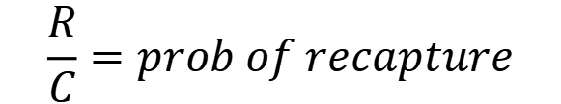
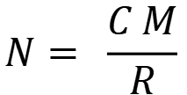
Abundance estimation in CLOSED POPULATIONS
Mark-recapture at its simplest:
the Lincoln-Peterson estimator
封闭种群的丰度估计——“标记-重新捕获”的最简单估算：
林肯-彼得森估算法
Design: visit site TWICE
first visit: count and mark all animals found (marks not unique)
second visit: count all marked and unmarked animals caught
M = Number marked the first visit
C = Total number captured on 2nd sampling occasion
R = Number captured on 2nd sampling occasion which have been marked (recaptures)
采样设计：在样地进行两次采样
1、第一次采样：计数并标记所有发现的动物（标记不唯一）
2、第二次采样：计数第一次已标记和未标记的所有捕获到的动物。
M=第一次采样时捕获并标记的动物数量
C=第二次采样时捕获到的所有动物数量
R=第二次采样时捕获到的第一次标记的动物数量（再捕获）
$$N= \frac{C M}{R}$$
$$\frac{R}{C}=prob of recapture$$
Notes:
1. Research CAPTURES, MARKS, and RELEASES as many individuals as possilbe, # Marked = M
2. Allows enough time for the marked individuals to MIX back into the POPULATION,
3. RESAMPLES the POPULATIONS, recording how many individuals sampled (S) and how many of them possed the mark from the 1st visit and are therefore recaptured (r)
Assuming that the proportion of the total population that was marked during the first sampling m/N is = to the proportion that individuals aptured during 2nd period that were recaptured……
IMPORTANCE of UNDERSTANDING THE DIRECTION OF BIASES – MEANS WE CAN MODEL THEM!!

Slide 19
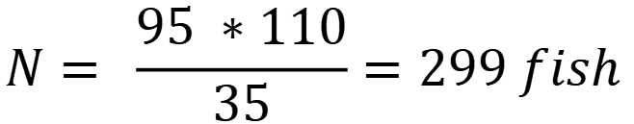
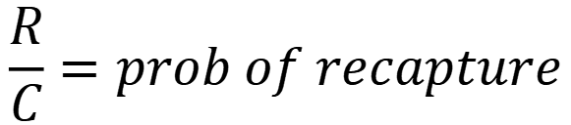
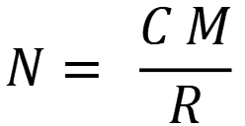
Abundance estimation in CLOSED POPULATIONS
Mark-recapture at its simplest:
the Lincoln-Peterson estimator
封闭种群的丰度估计——“标记-重新捕获”的最简单估算：
林肯-彼得森估算法
M = Number marked the first visit
C = Total number captured on 2nd sampling occasion
R = Number captured on 2nd sampling occasion which have been marked (recaptures)
M=第一次采样时捕获并标记的动物数量
C=第二次采样时捕获到的所有动物数量
R=第二次采样时捕获到的第一次标记的动物数量（再捕获）
$$N= \frac{C M}{R}$$
$$\frac{R}{C}=prob of recapture$$
Let’s assume we sample a popn. of fish
假设我们对鱼群进行采样
M = 110
C = 95
R = 35
$$N= \frac{95 ∗110}{35}=299 fish$$
Notes:
1. Research CAPTURES, MARKS, and RELEASES as many individuals as possilbe, # Marked = M
2. Allows enough time for the marked individuals to MIX back into the POPULATION,
3. RESAMPLES the POPULATIONS, recording how many individuals sampled (S) and how many of them possed the mark from the 1st visit and are therefore recaptured (r)
Assuming that the proportion of the total population that was marked during the first sampling m/N is = to the proportion that individuals aptured during 2nd period that were recaptured……
IMPORTANCE of UNDERSTANDING THE DIRECTION OF BIASES – MEANS WE CAN MODEL THEM!!

Slide 20
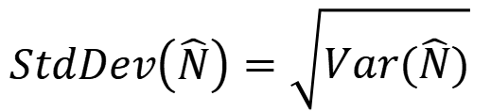
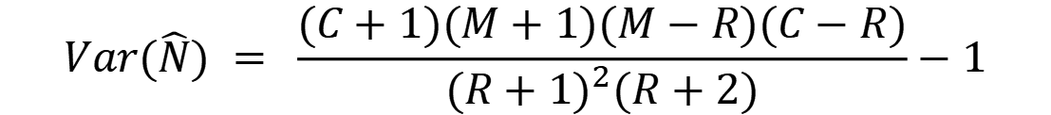
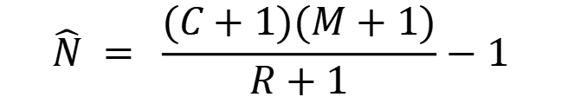
Abundance estimation in CLOSED POPULATIONS
Modified L-P estimator (Chapman estimator)
封闭种群的丰度估计
修正的 L-P 估算法（查普曼估算法）
SAME design as L-P 与L-P相同的采样设计
BUT, we need to account for sampling uncertainty (i.e., do we get the same numbers of C, M, R if we repeated the sampling 100 times in the same population?)
但是我们需要考虑采样的不确定性（即如果我们在同一种群中重复采样 100 次，是否会得到相同数量的 C、M、R？）
$$\hat{N} = \frac{(C+1)(M+1)}{R+1}−1$$
Let’s assume we sample a popn. of fish
假设我们对鱼群进行采样
M = 110
C = 95
R = 35
Compute Sampling Variance 计算采样方差
$$Var(\hat{N}) = \frac{(C+1)(M+1)(M−R)(C−R)}{{(R+1)}^{2}(R+2)}−1$$
$$StdDev\left(\hat{N}\right)=\sqrt{Var(\hat{N})}$$
$$95\% CI of \hat{N}= \hat{N} ±1.96 ∗StdDev(\hat{N})$$

Slide 21
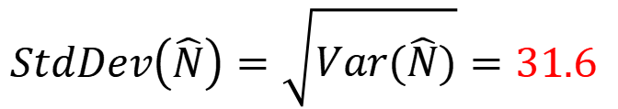
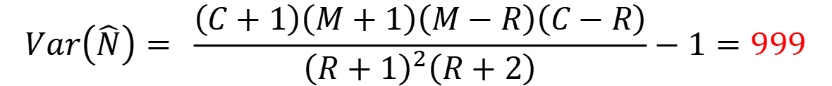
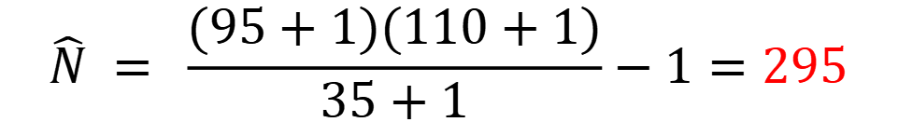
Abundance estimation in CLOSED POPULATIONS
Modified L-P estimator (Chapman estimator)
封闭种群的丰度估计
修正的 L-P 估算法（查普曼估算法）
Let’s assume we sample a popn. of fish 假设我们对鱼群进行采样
M = 110
C = 95
R = 35
$$\hat{N} = \frac{(95+1)(110+1)}{35+1}−1=295$$
$$Var\left(\hat{N}\right)= \frac{\left(C+1\right)\left(M+1\right)\left(M−R\right)\left(C−R\right)}{{\left(R+1\right)}^{2}\left(R+2\right)}−1=999$$
$$StdDev\left(\hat{N}\right)=\sqrt{Var(\hat{N})}=31.6$$
$$95\% CI of \hat{N}= \hat{N} ±1.96 ∗StdDev\left(\hat{N}\right)=295 ±62$$

Slide 22
Abundance estimation in CLOSED POPULATIONS
Schnabel Estimator
封闭种群的丰度估计
施纳贝尔估算法
Design: visit site multiple times
mark all animals during first visit
subsequent visits – mark all the unmarked animals (no unique marks needed)
采样设计：在样地进行多次采样
第一次采样时标记所有动物
后继采样—标记所有之前未标记的动物（不需要唯一标记）

Slide 23
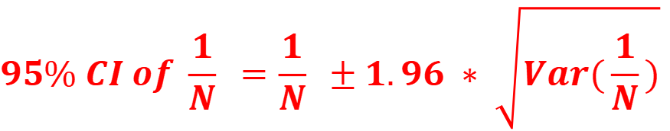
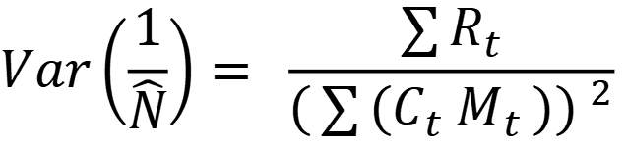
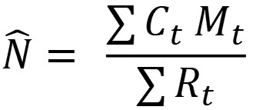
Abundance estimation in CLOSED POPULATIONS
Schnabel Estimator
封闭种群的丰度估计
施纳贝尔估算法
C_{t} = Total number of individuals captured during visit t
R_{t} = Number of previously-marked individuals (Recaptures) captured in visit t (the remainder of individuals captured in visit t must be given a new mark)
M_{t} = Total number of marked animals in the population just before the t^{th} site visit.
C_{t} = 采样 t 期间捕获的个体总数
R_{t} = 在采样 t 期间捕获到的先前标记的个体（再捕获）数量（在第 t 次采样中捕获的其余个体必须重新标记）
M_{t} = 在第 t 次采样之前，该种群中已标记的动物总数
$$\hat{N}= \frac{\sum{C_{t} M_{t}}}{\sum{R_{t}}}$$
R varies by sampling occasion, so N is basically a weighted average of L-P estimates
R 因不同采样而异，因此 N 基本上是 L-P 估算的加权平均值
$$Var\left(\frac{1}{\hat{N}}\right)= \frac{\sum{R_{t}}}{(\sum{{(C}_{t} M_{t}})) ^{2}}$$
$$95\% CI of \frac{1}{N} =\frac{1}{N} ±1.96 ∗ \sqrt{Var(\frac{1}{N})}$$

Slide 24
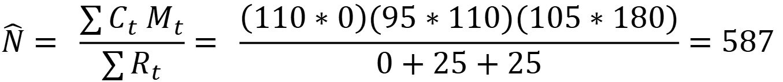
Abundance estimation in CLOSED POPULATIONS
Schnabel Estimator
封闭种群的丰度估计
施纳贝尔估算法
C_{t} = Total number of individuals captured during visit t
R_{t} = Number of previously-marked individuals (Recaptures) captured in visit t (the remainder of individuals captured in visit t must be given a new mark)
M_{t} = Total number of marked animals in the population just before the t^{th} site visit.
C_{t} = 采样 t 期间捕获的个体总数
R_{t} = 在采样 t 期间捕获到的先前标记的个体（再捕获）数量（在第 t 次采样中捕获的其余个体必须重新标记）
M_{t} = 在第 t 次采样之前，该种群中已标记的动物总数
Sampling occasion | Ct | Rt | New marked | Mt
1 | 110 | 0 | 110 | 0
2 | 95 | 25 | 70 | 110
3 | 105 | 25 | - | 180
$$\hat{N}= \frac{\sum{C_{t} M_{t}}}{\sum{R_{t}}}= \frac{\left(110∗0\right)(95∗110)(105∗180)}{0+25+25}=587$$

Slide 25
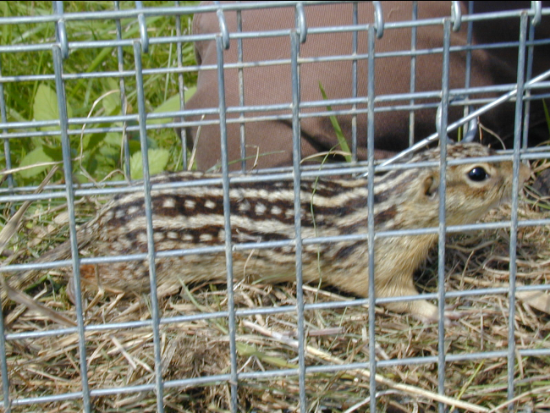
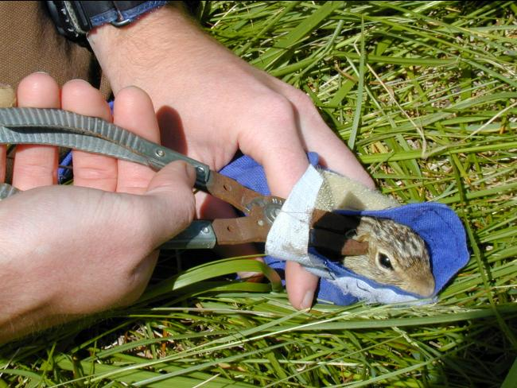
Assumptions for the L-P estimator and friends
林肯-彼得森估计法的假设条件
Population is “closed”: between sessions, no animals leave or enter study area, are born, or die
All individuals have equal probability of being captured
No effect of marking on probability of recapture or survival
Mixing of marked and unmarked individuals
Marks are not lost
种群是“封闭”的：在不同采样期间，没有动物离开或进入研究区域，也没有动物出生或死亡
所有个体被捕获的概率相同
做标记对重新捕获或存活的概率没有影响
在种群中，已标记和未标记的个体混合在一起
标记不会丢失
Notes:
Visual detection of tags, slow individuals down….

Slide 26
Open Populations
开放种群
Population is open to one or more of the BIDE processes
  abundance CAN change and attempt to estimate the processes driving abundance change (often, survival rates; emigration and immigration are trickier)
Enables estimation of the drivers of population dynamics over extended time periods
PROGRAM MARK (to date >100 different variations of capture-recapture models have been developed): http://www.phidot.org/software/mark/
种群对于BIDE过程中的一个或多个过程是开放的
即其丰度可以发生变化，并尝试估计驱动丰度变化的过程（通常是存活率；而迁入和迁出较为棘手）。
可估算较长时期内种群动态的驱动因素
PROGRAM MARK（迄今已开发了100多种不同的“捕获—再捕获”模型的程序）：http://www.phidot.org/software/mark/

Slide 27
Cormack-Jolly-Seber
Open Population Model
科马克-乔利-塞伯
开放式群落模型
All individuals in population are equally detectable at each sampling occasion (each capture session represents a totally random sample from the population)
Marks are not lost or missed by surveyors
All emigration is permanent (equivalent to a mortality)
种群中的所有个体在每次采样时都能被相等概率地检测到（每次捕获都是从种群中完全随机采集的样本）
标记不会被丢失或被调查员遗漏
所有迁出都是永久性的（相当于死亡）

Slide 28
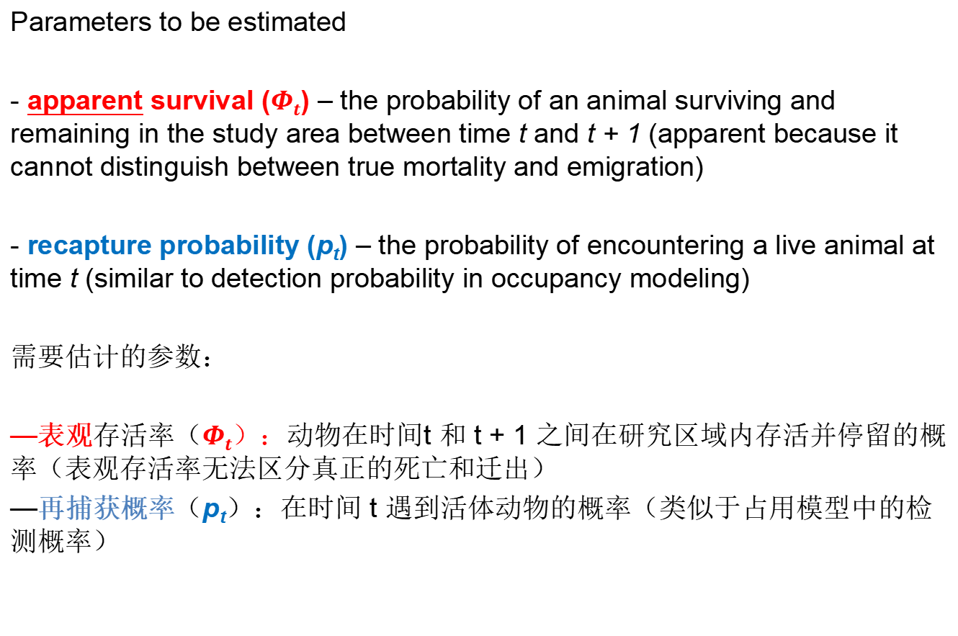
Cormack-Jolly-Seber
Open Population Model
科马克-乔利-塞伯
开放式群落模型
Parameters to be estimated
- apparent survival ($Φt$) – the probability of an animal surviving and remaining in the study area between time t and t + 1 (apparent because it cannot distinguish between true mortality and emigration)
- recapture probability (p_{t}) – the probability of encountering a live animal at time t (similar to detection probability in occupancy modeling)
需要估计的参数：
—表观存活率（$Φt$）：动物在时间t 和 t + 1 之间在研究区域内存活并停留的概率（表观存活率无法区分真正的死亡和迁出）
—再捕获概率（p_{t}）：在时间 t 遇到活体动物的概率（类似于占用模型中的检测概率）

Slide 29
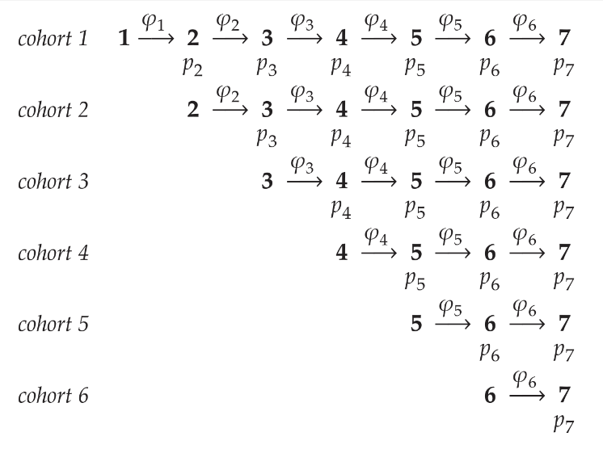

Cormack-Jolly-Seber
Open Population Model
科马克-乔利-塞伯
开放式群落模型
Consider the following model
请看下面的模型:
$$\left\{Φ_{t}, p_{t}\right\}$$
survival and recapture vary by time
存活率和再捕获率因时间而异
A cohort is released and survives and is recaptured with different prob’s each time
一个特定群体被释放后存活下来，并被重新捕获，每次的概率都不同

Slide 30
Cormack-Jolly-Seber
Open Population Model
科马克-乔利-塞伯
开放式群落模型
Consider the following model
请看下面的模型:
$$\left\{Φ_{t}, p_{t}\right\}$$
survival and recapture vary by time
存活率和再捕获率因时间而异
More animals are marked and released into the population each subsequent survey, aka new ‘cohorts’
每次调查都会有更多的动物被标记并放归种群，也就是新的“特定群体”
We have 6 estimates for survival and 6 for recapture
我们有 6 个存活率估计数和 6 个重新捕获率估计数

Slide 31

Cormack-Jolly-Seber
Open Population Model
科马克-乔利-塞伯
开放式群落模型
Consider the following model
请看下面的模型:
$$\left\{Φ_{t}, p\right\}$$
recapture DOES NOT vary by time
再捕获率不因时间而异
How many survival and recapture estimates?
存活率和重新捕获率的估计值有多少个呢？
Still 6 estimates for survival, but only 1 for recapture (constant recapture prob through time)
存活率仍有 6 个估计值，但重捕率只有 1 个估计值（因为重捕率在时间上保持不变）

Slide 32

Cormack-Jolly-Seber
Open Population Model
科马克-乔利-塞伯
开放式群落模型
Consider the following model
请看下面的模型:
$$\left\{Φ, p\right\}$$
neither parameter varies by time
两个参数都不随时间变化
How many survival and recapture estimates?
存活率和重新捕获率的估计值有多少个呢？
Only 1 estimate for survival and only 1 for recapture (constant surv and recapture prob through time)
只有 1 个存活率估计值和 1 个重捕率估计值（存活率和重捕率在不同时期保持不变）

